Slide 1

Mesh-less Methods for Structural Analysis
Presented by:
Navpreet KAUR
(Major: Structures + ADO)
Supervisors:
Joseph MORLIER
Simone CONIGLIO
26/06/2019

Slide 2
Outline of the Presentation
Introduction
State of the Art
Problem Definition (Test Case)
Previous Work Done
Proposed Work and Results
Conclusion
References

Slide 3
Introduction
Why not mesh-based methods?
Mesh-less methods
Complex structures
Moving boundaries
Discontinuous structures
Large deformations

Slide 4
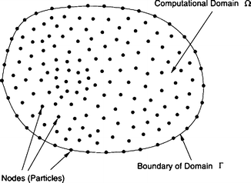
Introduction
How mesh-less methods work?
Nodal mesh generation
Generation of shape function through the nodes
Discretized equations based on global/weak form
Global matrix assembly
Essential boundary conditions (EBCs) or support conditions.
Solution for displacement
Solution for stress and strain

Slide 5
Introduction
Applications of mesh-less methods
Solid mechanics
Fracture mechanics
Composite structures
Heat conduction Problems
many more….

Slide 6
Outline of the Presentation
Introduction
State of the Art
Problem Definition (Test Case)
Previous Work Done
Proposed Work and Results
Conclusion
References

Slide 7
State Of The Art
Smooth Particle Hydrodynamics by Lucy(1977)
Diffuse Element Method by Nayroles et al.(1992)
Element free Galerkin Method by Belytschko et al.(1994)
Reproducing Kernel Particle Method by Liu et al.(1995)
Hp-clouds Method by Duarte and Oden(1996)
Partition of Unity Method by Babuska and Melenk(1997)
Mesh-less local Petrov Galerkin method by Atluri and Zhu(1998)
Mesh-less Natural Element method by Yvonnet(2004)

Slide 8
State Of The Art
Element Free Galerkin (EFG)
Mesh-less local Petrov Galerkin (MLPG)
Not a true mesh-free method.
Based on Moving Least Squares (MLS) approximation.
Based on the global weak form.
Background mesh is required to evaluate the integrals.
Required to impose the EBCs.
A true mesh-free method.
Based on Moving Least Squares (MLS) approximation.
Based on local weak form.
No background mesh is required to evaluate the integrals
Required to impose the EBCs.

Slide 9
Outline of the Presentation
Introduction
State of the Art
Problem Definition (Test Case)
Previous Work Done
Proposed Work and Results
Conclusion
References

Slide 10
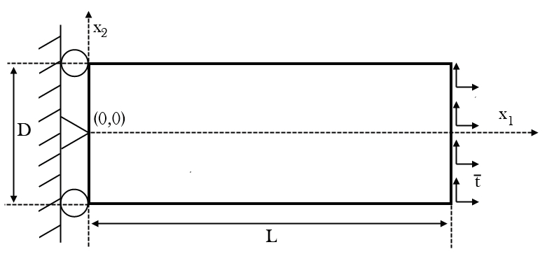
Problem Definition
Parameters | Values
Length (L) | 48 mm
Width (D) | 12 mm
Maximum parabolic loaded force (P) | 0.1 N
Elasticity modulus (E) | 1 MPa
Poisson’s ratio | 0.3

Slide 11
Outline of the Presentation
Introduction
State of the Art
Problem Definition (Test Case)
Previous Work Done
Proposed Work and Results
Conclusion
References

Slide 12
Previous Work Done
Comparison of EFG and MLPG results.
Comparison of different nodal distribution with EFG method:
Uniform nodal distribution
Random nodal distribution
Semi-random nodal distribution

Slide 13
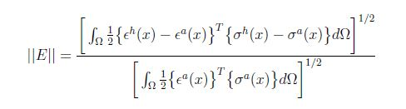
Previous Work Done
Comparison Parameter
Error norm
The error norm is calculated by determining the relative error between the elastic energy of the analytical solution and the approximated solution as given in following equation:
where, h and a superscripts represent approximated and analytical solution respectively.

Slide 14
Previous Work Done
Mesh-less discretization parameters
Parameters | Values
Nodes in x1-direction | 50
Nodes in x2-direction | 50
Influence domain shape | Rectangular
Integration cells in x1-direction | 49
Integration cells in x2-direction | 49
Integration points per cell | 4
Local influence domain size(EFG) | 2.5
Local influence domain size(MLPG) | 1.15

Slide 15
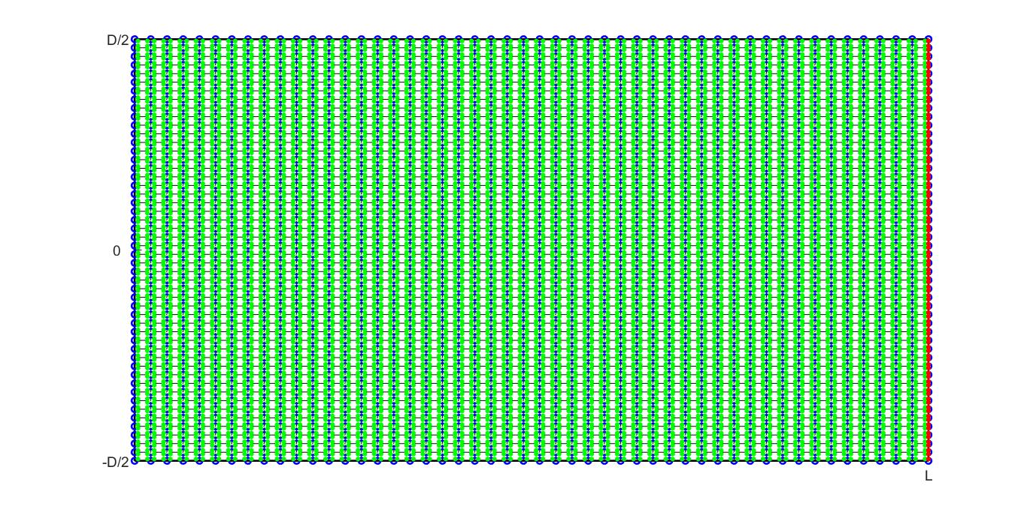
Previous Work Done
Comparison of EFG and MLPG results
EFG
Mesh

Slide 16
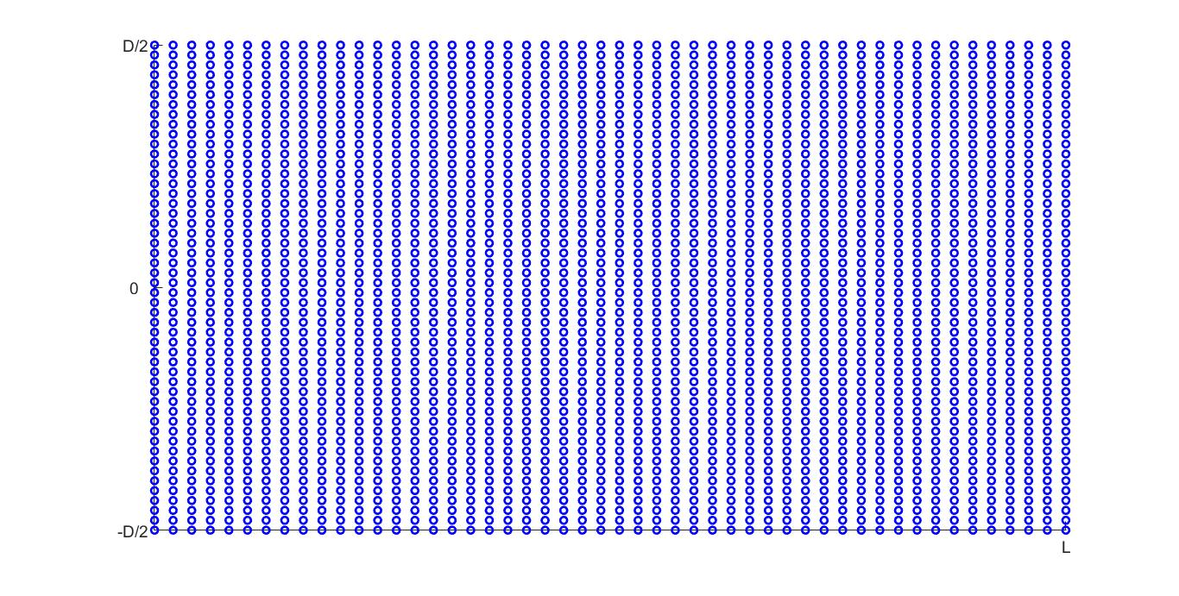
Previous Work Done
Comparison of EFG and MLPG results
MLPG
mesh

Slide 17
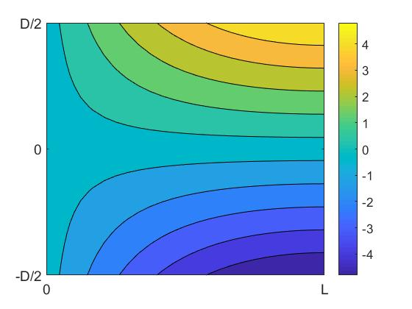
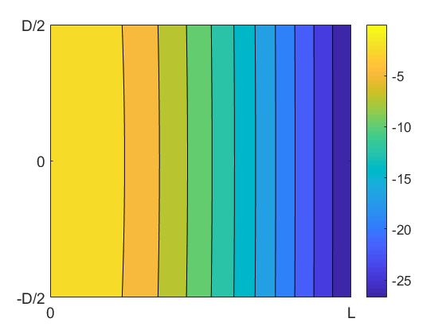
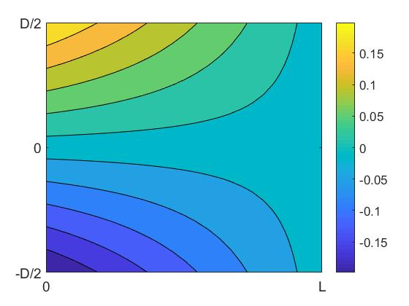



Previous Work Done
Comparison of EFG and MLPG results
u₁
u₂
σ ₁₁
EFG (above) and MLPG(below)

Slide 18
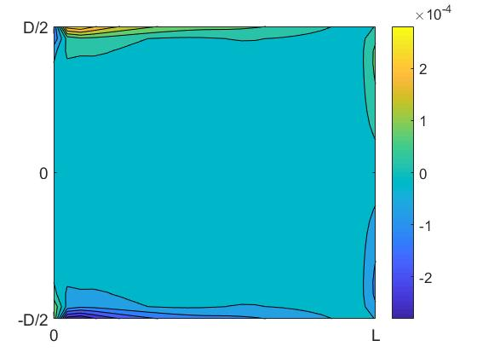
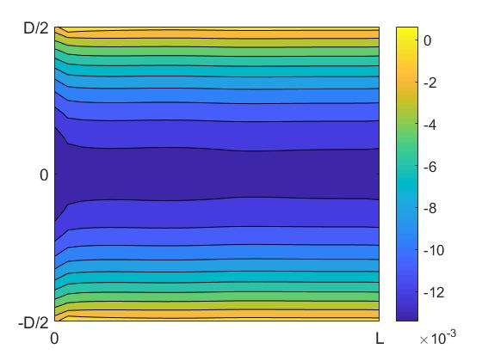
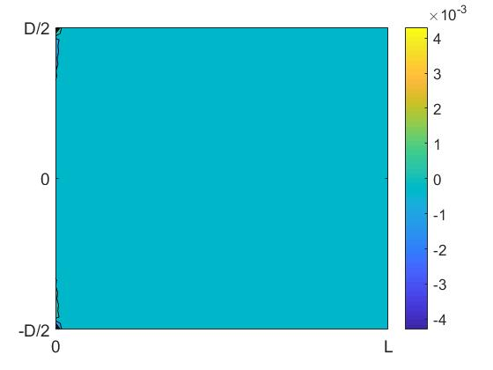
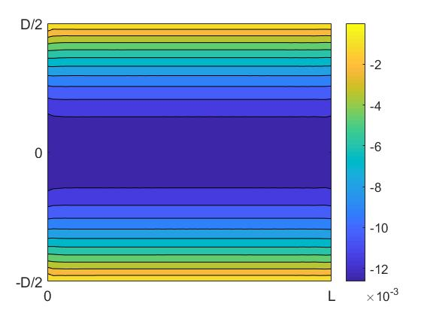
Previous Work Done
Comparison of EFG and MLPG results
σ ₂₂
σ ₁₂
EFG (above) and MLPG(below)

Slide 19
Previous Work Done
Comparison of EFG and MLPG results
Mesh-less method | Error norm value
EFG | 0.0015
MLPG | 0.0057

Slide 20
Previous Work Done
Comparison of different nodal distributions
Nodal Distribution | Description
Uniform | The nodes are defined uniformly all over the domain in both the axis as a rectangular grid.
Random | The problem domain is discretized by randomly distributed nodes.
Semi-random | The nodes are first distributed uniformly over the whole domain and then they are displaced from their position depending upon the perturbation parameter that has taken as 0.5
1000 simulations are done to calculate the mean values of the error norm for random and semi-random distribution.

Slide 21
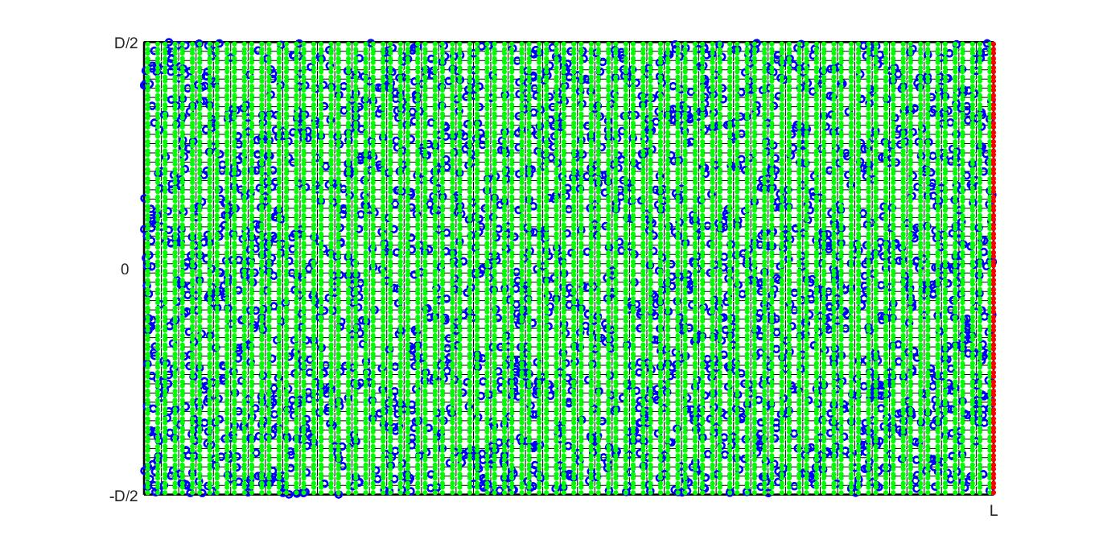
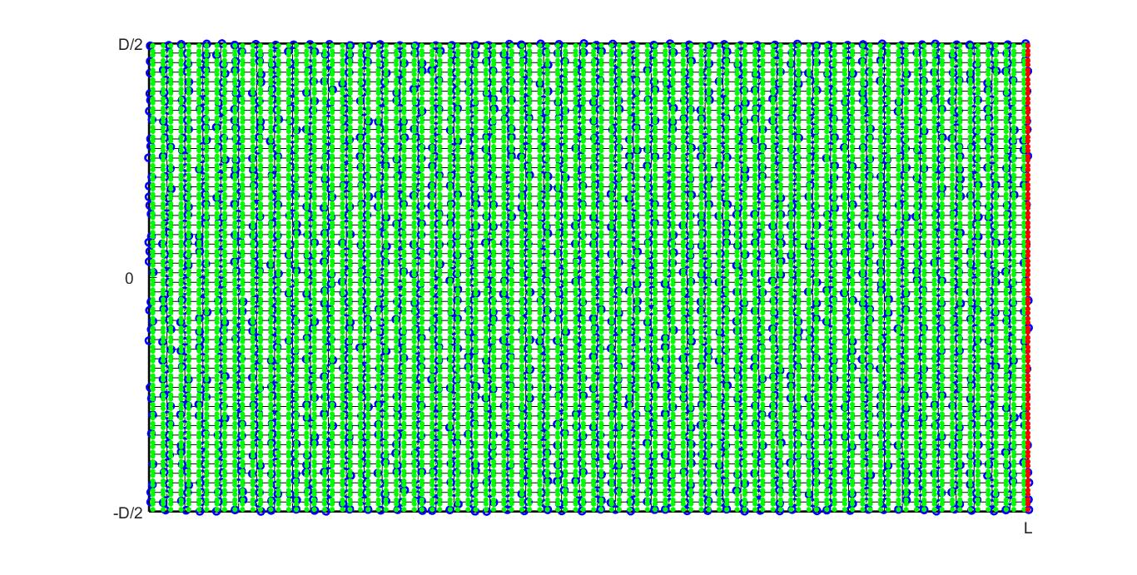
Previous Work Done
Comparison of different nodal distributions
Uniform
Random
Semi-random

Slide 22
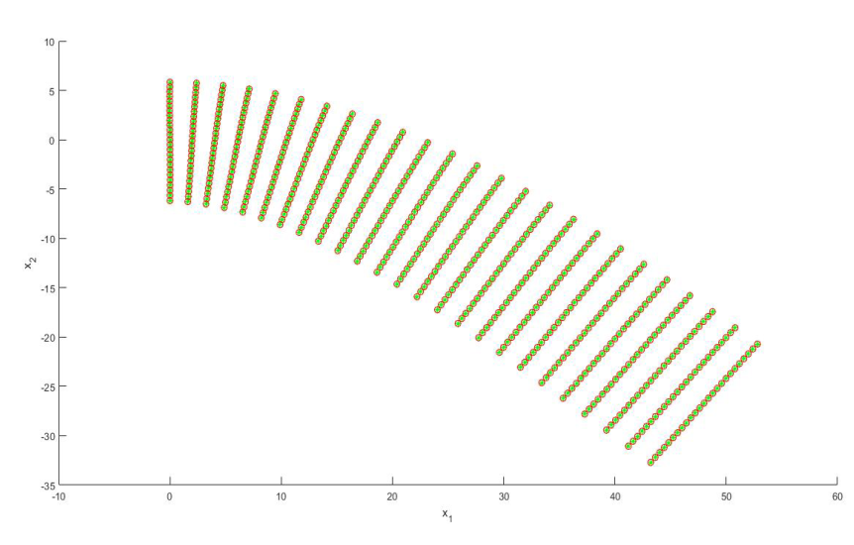
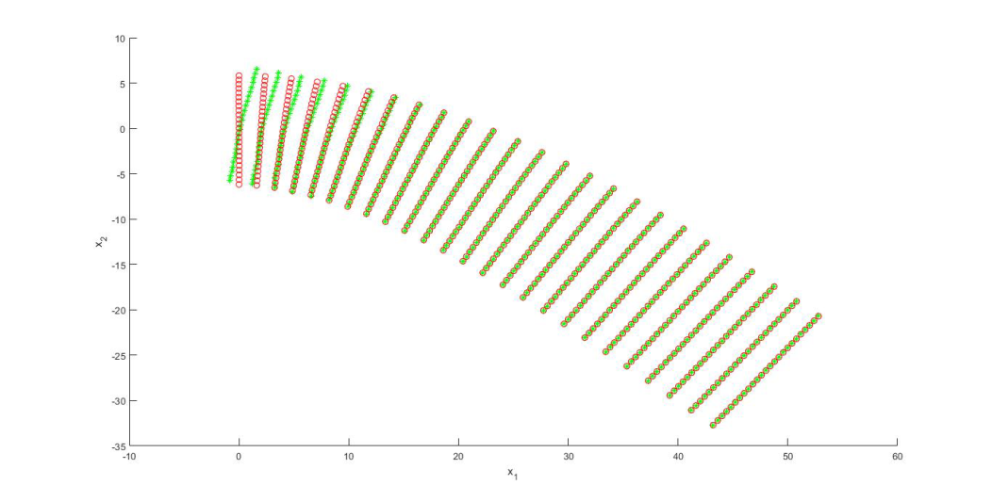

Previous Work Done
Comparison of different nodal distributions
Uniform
Random
Displacement comparison between analytical and approximated solution
Semi-random

Slide 23
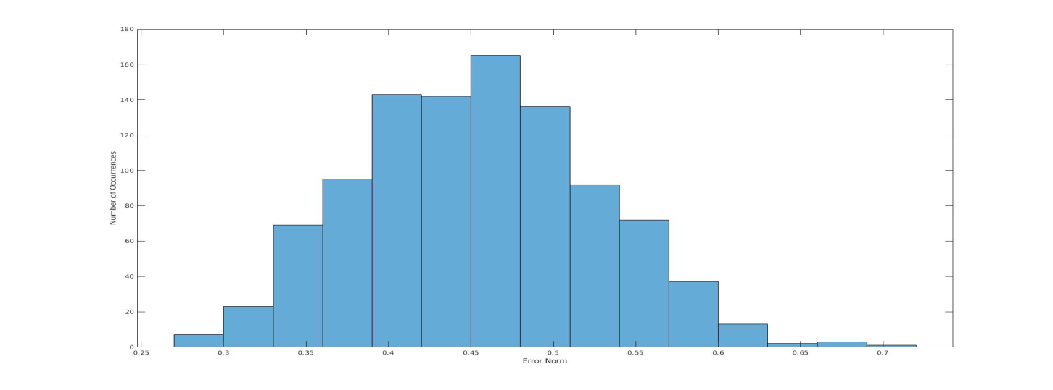
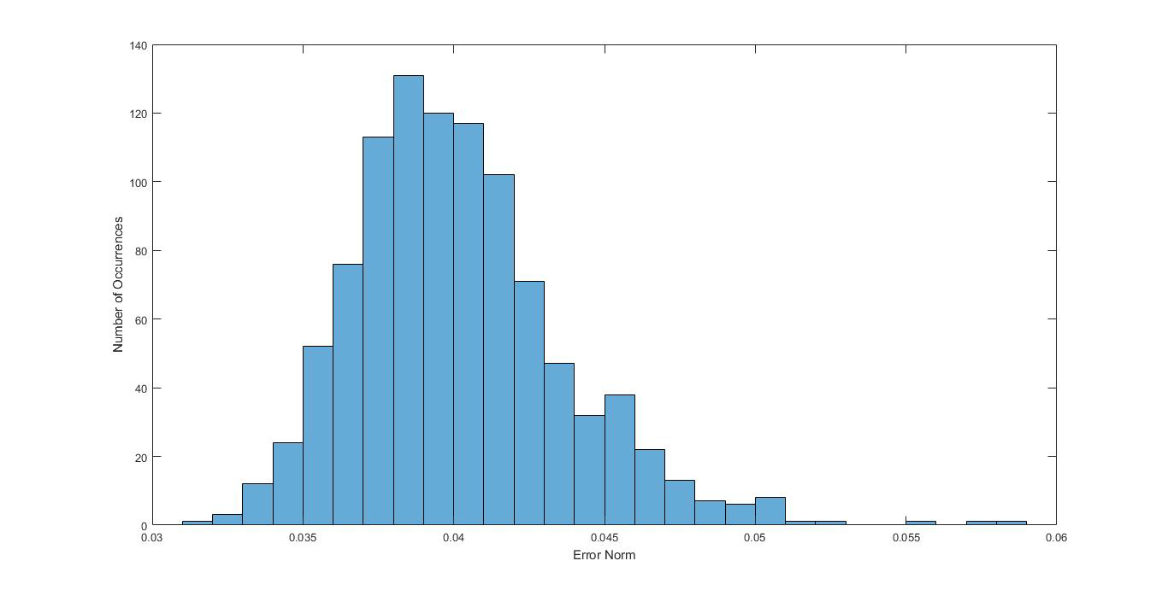
Previous Work Done
Comparison of different nodal distributions
Occurrence frequency distribution of error norm
Random
Semi-random

Slide 24
Previous Work Done
Comparison of different nodal distributions
Nodal Distribution | Error norm value
Uniform | 0.0015
Random | 0.4543
Semi-random | 0.0402

Slide 25
Outline of the Presentation
Introduction
State of the Art
Problem Definition (Test Case)
Previous Work Done
Proposed Work and Results
Conclusion
References

Slide 26
Proposed Work Done
Proposed nodal distributions
Latin hyper-cube sampling
Halton sampling
Sobol sampling

Slide 27
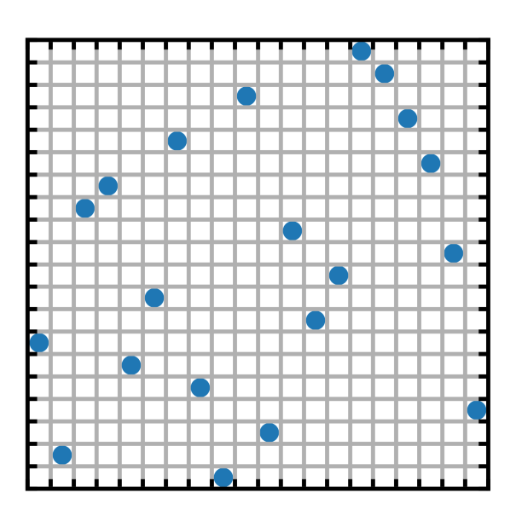
Proposed Work Done
Latin hyper-cube sampling (LHS)
This sampling method was introduced by McKay et al.[7] in 1979.
LHS is a sampling method based on stratified approach ensuring that all the fractions of the defined domain are sampled.
Different approaches have been introduced in the literature like, Optimal LHS where the uniformity is measured in terms of two parameters i.e, maximin and correlation to improve the traditional LHS uncertainty.
Example for LHS (Ref-11)
1000 simulations are done to calculate the mean values of the error norm for LHS nodal distribution.

Slide 28
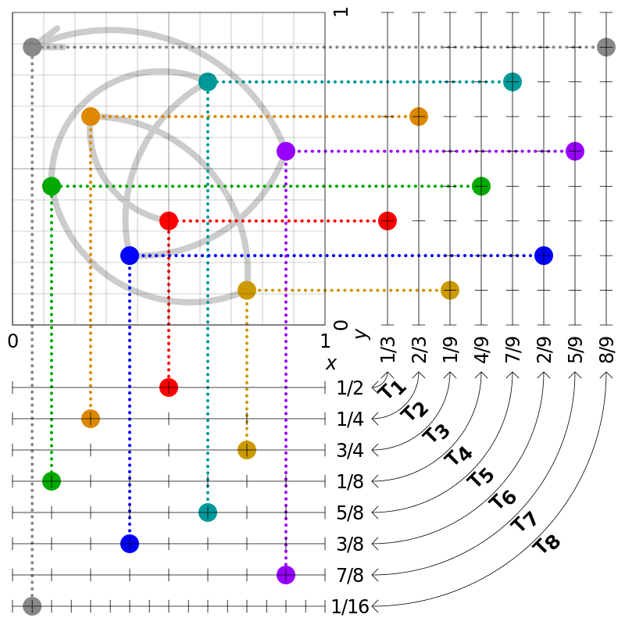
Proposed Work Done
Halton sampling
The Halton sampling is a category of Quasi-Random Point sequence and was first proposed by Halton[9] in 1964.
This sampling provides the deterministic sampling yet the sampling appears to be random. The Halton sampling utilizes various prime bases to discretize the domain uniformly in each of the dimensions.
Example of Halton sequence used to generate points in (0, 1) × (0, 1) in R² taking one dimension of the Halton sequence to be based on 2 and the other on 3.

Slide 29
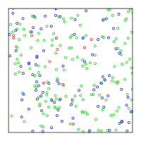
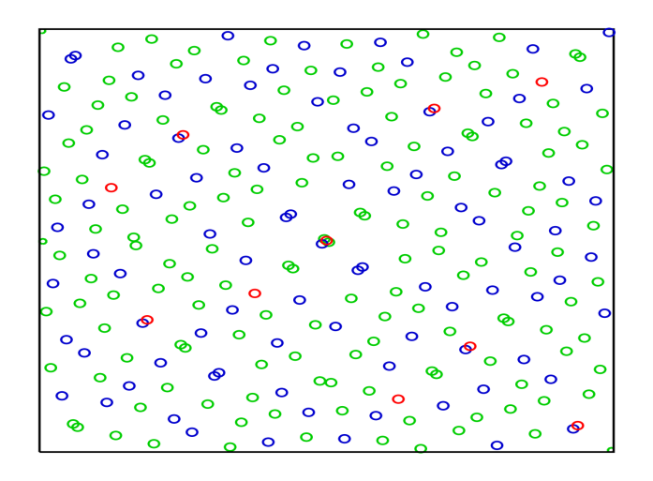
Proposed Work Done
Sobol sampling (LHS)
The Sobol Sampling is another category of Quasi-Random low discrepancy sequences which was proposed first in 1967 by a Russian mathematician Ilya M. Sobol[10].
Similar to the principle of Halton Sampling, there is only one major difference between the two that in Sobol sampling, the prime bases in every sequence is the same and is equal to 2..
Random
Sobol
1000 simulations are done to calculate the mean values of the error norm for sobol sampling nodal distribution.

Slide 30
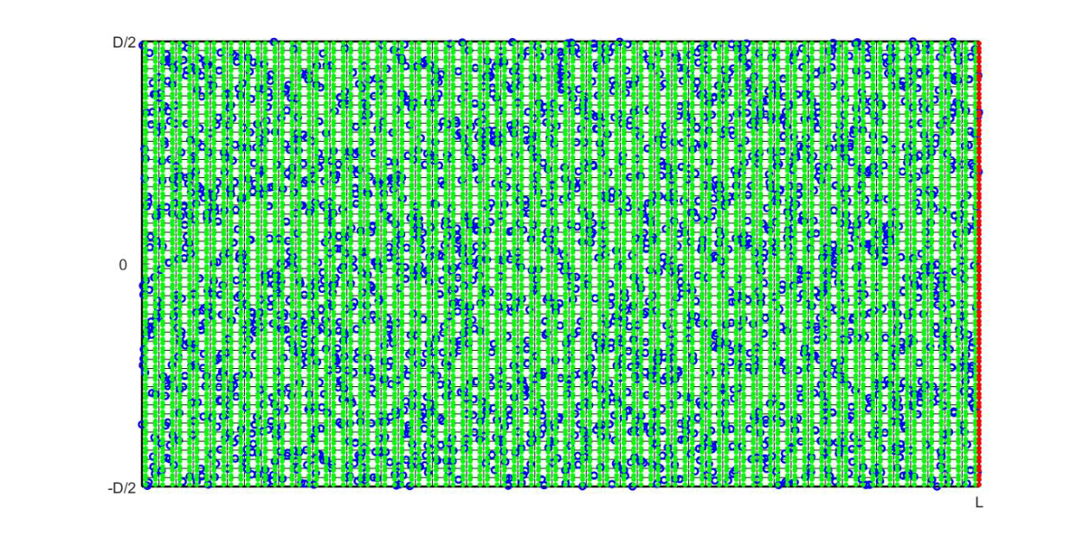
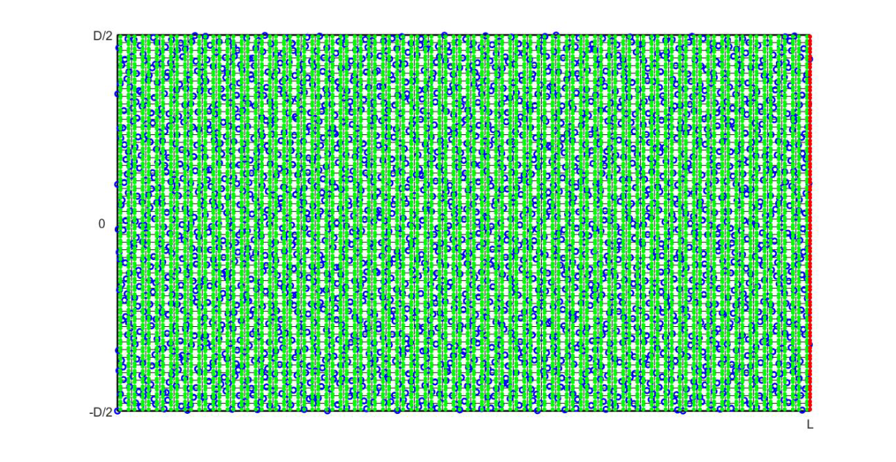
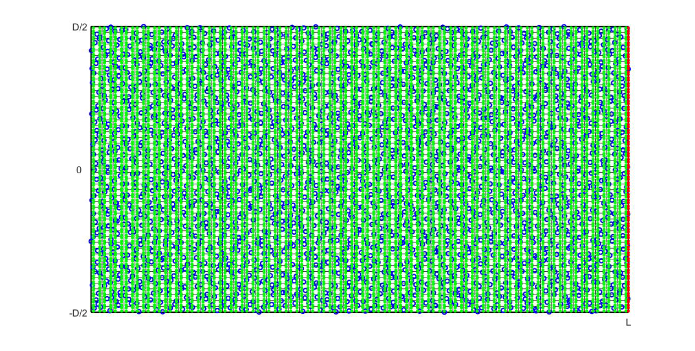
Proposed Work Done
Comparison of proposed nodal distributions
LHS
Halton
Sobol

Slide 31
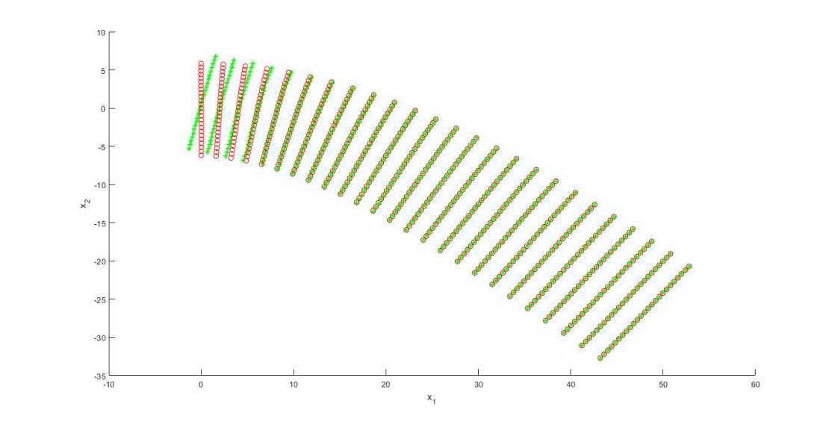

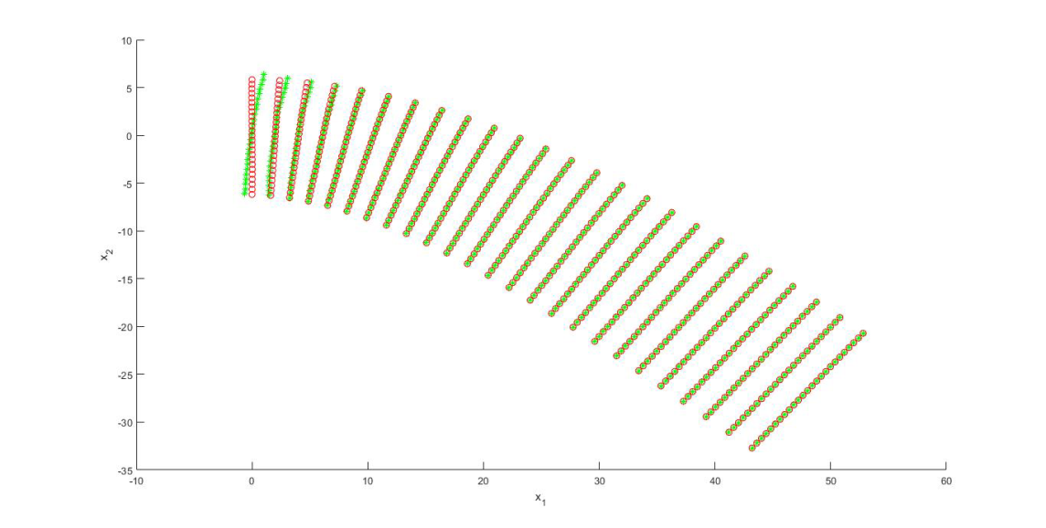
Proposed Work Done
Comparison of proposed nodal distributions
LHS
Halton
Displacement comparison between analytical and approximated solution
Sobol

Slide 32
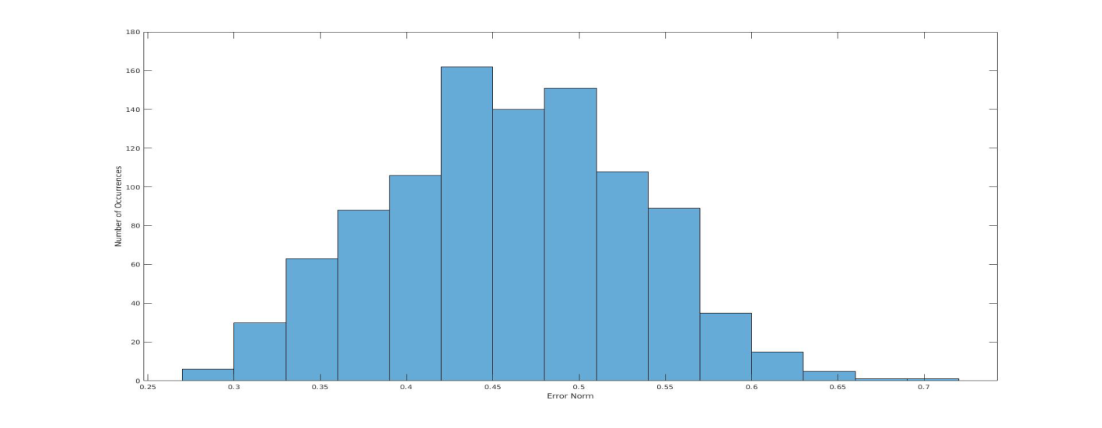
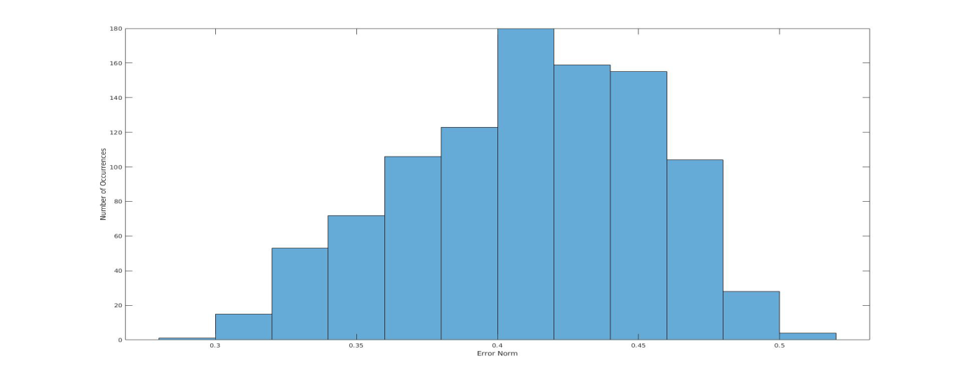
Proposed Work Done
Comparison of proposed nodal distributions
Occurrence frequency distribution of error norm
LHS
Sobol sampling

Slide 33
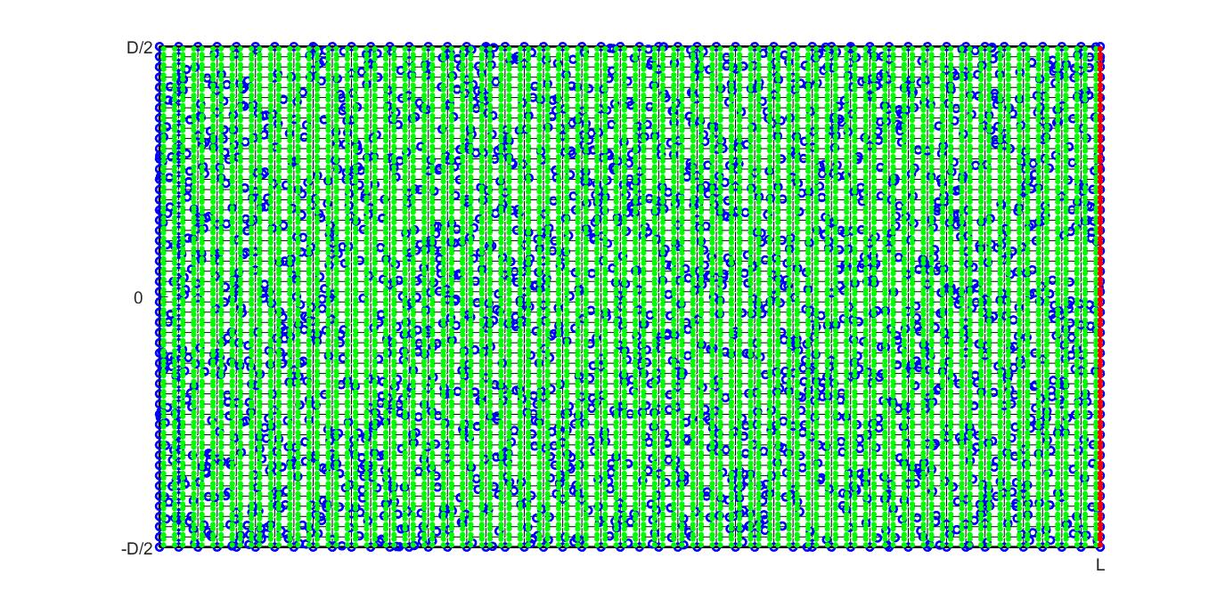
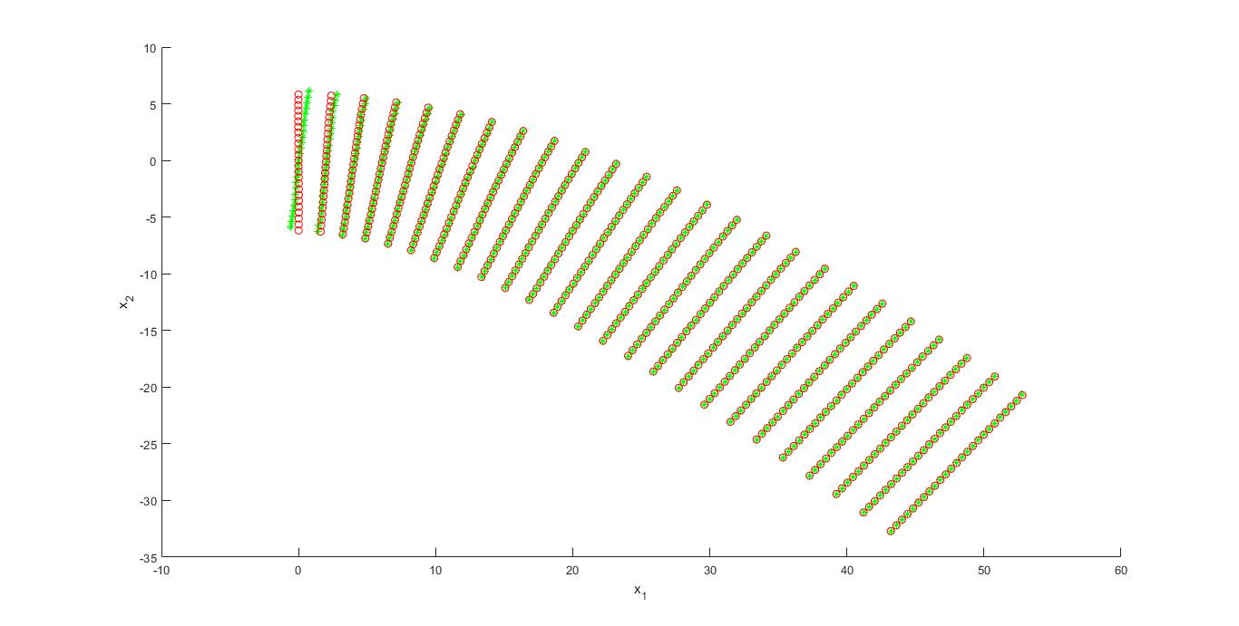
Proposed Work Done
Comparison of proposed nodal distributions
Another test for nodal distribution (Improved LHS)
Nodal distribution
Displacement comparison

Slide 34
Proposed Work Done
Comparison of proposed nodal distributions
Nodal Distribution | Error norm value
LHS | 0.4592
Halton Sampling | 0.3674
Sobol Sampling | 0.4113

Slide 35
Conclusion
Table below summarizes all the nodal distributions studied.
With lowest value of error norm, uniform sampling provides the best fit to the analytical solution.
The results obtained with LHS, Halton and sobol sampling are far deviated from the analytical solution. Since there is no previous work done on the same, the work could be considered for research publication.
Therefore, for future work uniform sampling will be considered.
Nodal Distribution | Error norm value
Uniform | 0.0015
Random | 0.4543
Semi-random | 0.0402
LHS | 0.4592
Halton Sampling | 0.3674
Sobol Sampling | 0.4113

Slide 36
References
[1] Overvelde, J.T.B., (2012). The Moving Node Approach in Topology Optimization -An Exploration to a Flow-inspired Meshless Method-based Topology Optimization Method. Master’s Thesis - Delft University of Technology.
[2] Majérus Julien and Verheylewegen Guillaume, Project Presentation, Element-Free Galerkin Method, University of Liège, 01/03/2010.
[3] V. P. Nguyen, T. Rabczuk, S. Bordas, and M. Duflot, “Meshless methods: a review and computer implementation aspects,” Mathematics and Computers in Simulation, vol. 79, no. 3, pp. 763–813, 2008.
[4] S. D. Daxini and J. M. Prajapati, " A Review on Recent Contribution of Meshfree Methods to Structure and Fracture Mechanics Applications", The Scientific World Journal Volume 2014, Article ID 247172, 13 pages.
[5] Xiao Hua Zhang, Jie Ouyang and Lin Zhang, "Matrix free meshless method for transientheat conduction problems", International Journal of Heat and Mass Transfer 52 (2009) 2161–2165.
[6] Yongchang Cai, Pan Sun, Hehua Zhu and Timon Rabczuk, "A mixed cover meshless method for elasticity and fracture problems", Theoretical and Applied Fracture Mechanics 95 (2018) 73–103.
[7] McKay, M.D.; Beckman, R.J.; Conover, W.J. (May 1979). "A Comparison of Three Methods for Selecting Values of Input Variables in the Analysis of Output from a Computer Code". Technometrics (JSTOR Abstract), American Statistical Association. 21(2): 239–245.
[8] Tang, B. (1993). "Orthogonal Array-Based Latin Hypercubes". Journal of the American Statistical Association. 88 (424): 1392–1397.
[9] Halton, J. (1964), "Algorithm 247: Radical-inverse quasi-random point sequence", Communications of the ACM, 7: 701-705.
[10] Sobol,I.M. (1967), "Distribution of points in a cube and approximate evaluation of integrals". Zh. Vych. Mat. Mat. Fiz. 7: 784–802 (in Russian); U.S.S.R Comput. Maths.Math. Phys. 7: 86–112.
[11]TY - CHAPAU - Manzari, Mehrdad T.ED - Li, DongqingPY - 2013DA - 2013//TI - Meshless Methods BT - Encyclopedia of Microfluidics and Nanofluidics SP - 1EP - 14PB - Springer USCY - Boston, MASN - 978-3-642-27758
[12] Wikipedia - Halton Sequence
[13] Wikipedia - Sobol Sequence
[14] MATLAB – lhsdesgin(), haltonset() and sobolset().

Slide 37
Thank you
Questions?

